Slide 1
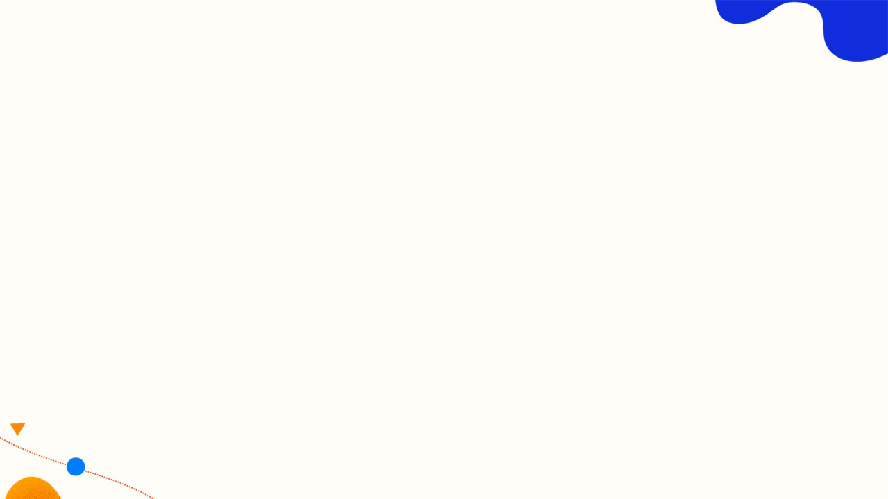
Circuit Hero - Mk II Interactive Prototype
A story-driven circuit learning game for 12-16 year-old learners
Product idea
Players act as a town circuit repairer. They complete repairs by building and testing circuits, learning through visual current flow and feedback.
Mk II scope
Tutorial + six sequential levels: basic circuit, switch, series, parallel, mixed/buzzer, and comprehensive challenge.
Submission note
Guest demo is limited to Level 1. The full prototype flow is evaluated as the logged-in six-level Mk II prototype.

Slide 2
Mk II Prototype Flow
Evaluation focuses on the learning interaction, not on account management
Start / tutorial
Level map
Build circuit
Power test
Feedback & hint
Concept recap
Unlock next level
Why six levels matter
The difficulty curve is part of the interaction design: users should move from simple closed circuits to branch-based reasoning and final free/comprehensive design.
What was evaluated
Tutorial clarity, component dragging, wire connection, power testing, error recovery, level progression, and learning feedback.

Slide 3
Evaluation Method
Heuristic inspection + controlled usability test
Heuristic evaluation
Evaluator inspected the tutorial, level map, six-level workspace flow, feedback messages, and recovery controls using Nielsen’s 10 heuristics.
User test tasks
T1: tutorial + Level 1 T2: Levels 2-3 T3: Levels 4-6 T4: recover from a failed circuit
Measures
Completion, time, number of errors, help requests, stuck points over 20 seconds, think-aloud notes, and five post-task questions.

Slide 4
Pilot Findings from Participants A-D
The core flow works; later-level wiring and diagnosis need refinement
Completion
4/4 completed Level 1-3. 3/4 completed Level 4-6 unaided. 4/4 completed with at least one hint available.
Common errors
Mis-selected terminals, testing before the circuit was complete, uncertainty around parallel branches, and over-reliance on trial-and-error.
Positive evidence
Users understood the repair story, enjoyed the success animation, and used current movement to check whether their mental model was correct.
Main risk
Failure messages tell users that the circuit is wrong, but not always why it is wrong in complex levels.

Slide 5
Recommended Mk II Improvements
Priority changes before final submission
High priority
1. Highlight active terminals and preview wires. 2. Diagnose failures: open circuit, short circuit, missing part, switch off. 3. Reduce Level 4-6 workspace clutter.
Medium priority
1. Add a persistent tutorial/help icon. 2. Make the “Next Level” button dominant after success. 3. Add concept cards for series vs parallel differences.
Design conclusion
Circuit Hero Mk II is ready as a six-level learning prototype. The next iteration should strengthen guidance and recovery as the circuit concepts become more complex.

